Slide 1
SEMINAR PRESENTATION
ON
MALE GAMETOPHYTE
SUBMITTED TO DIPARTMENT OF BOTANY
GOVT. DIGVIJAY AUTONOMOUS P.G. COLLEGE
RAJNANDGAON (C.G.)
Guided by:- presented by :-
Mr.mohit sahu sir rewantin patiyare
M.Sc botany (pre.)

Slide 2
Synopsis :-
Introduction
Definition
History
Structure of anther
Devlopment of anther
Structure of pollengrain
Dehiscence of anther
Devlopment of male gametophyte
Conclusion
Reference

Slide 3
Introduction :-
When we study about the structure of the flower . Than we know that stamen and carpel are important part of the flower .
Through this part reproduction with process take place .
Stamen is more up part two part anther and filament .
Filament support anther to attached with flower .
Formation of male gametes take place by the process of anther male gametogenesis .

Slide 4
History :-
First time scintest gerew considers . Stamen as the male reproduction organ given important to pollengrain .

Slide 5
Structure of anther :-
Anther is male reproductive organ are the flower , apical fertile part of the stamen .
It consist two or more than two microsporangia which is known as pollensacs .
In contain pollengrain .
Normally anther is tetrasporangiate , but some plant is bisporangiate anther .
The wall of mature anther is known up as four layer :-
Epidermis
Endothecium
Midfle layer
Tapetum

Slide 6
Structure of anther

Slide 7
Development of anther :-

Slide 8
Structure of pollengrain :-
Pollengrain considers on the first cell of the male gametophyte generation .
Study it pollengrain process of known as palynology .
The cradit of the structural study of the pollengrain is given to kolreater , erdhman is known as the father of the palynology .
The shape and size of the pollengrain are different types of spesics . But normally it is in ovad shaped .
The wall is the pollengrain of divid into two layers in which outer wall ,is known as exine , and inner wall is known as intine .
Which is rare up pectose and cellulose .

Slide 9
Str

Slide 10
Dehiscence of anther :-
Firstly middle layer and tapetum distryed .
Due to which in anther wall only epidermis and endothecium remain .
Normally it is because of development of dehiscence longitudinal slits .
In some plants it is allso because of the development of dehiscence terminal slits or pores .
Loss of water take place during the maturity of endothecium and the outer wall of the cell get compact .
As a result there is stress in stomium , in this way by dehiscence pollengrain become free .

Slide 11
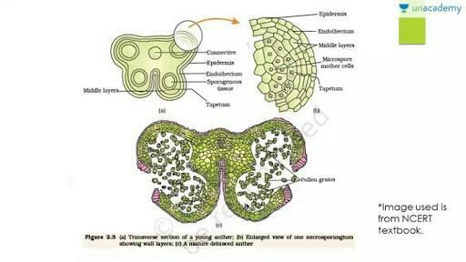
Dehiscence of anther

Slide 12
Delopement of male gametophyte :-

Slide 13
Reference :-
S.S. BHOJWANI – THE EMBRYOLOGY OF ANGIOSPERM
S.P. BHATNAGAR – THE EMBRYOLOGY OF ANGIOSPERM

Slide 14
Thank you

